Slide 1
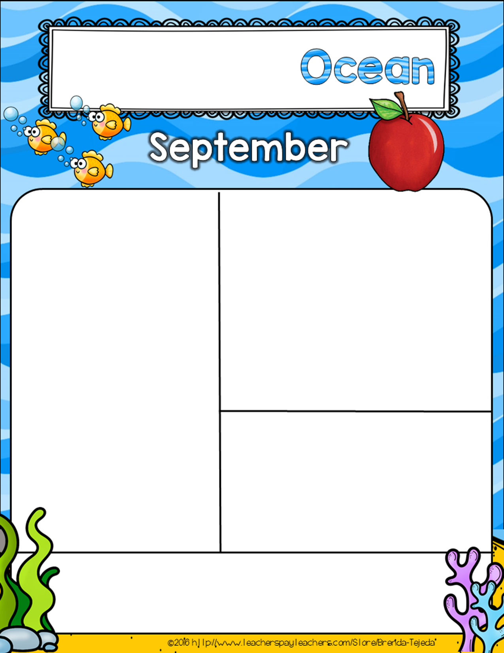
Mrs. Glenn’s
Week of September 27th
October 1 – NOON DISMISSAL
October 4 – Blessing of the Animals @ 2pm
October 5 – Mass with the Bishop @ 8:30
October 8 – “Be a Pioneer”Day
Focus for the Week
Reading –
Math – Numbers to Ten
Phonics – Letter Tt
Religion – God gives us plants and animals
Science – Animal/Plant needs
Your child Will be bringing home Math homework. It Will be found on the Right side of their folder. Please complete and return.
Thank you for all of your support with the Fun Run. It is greatly appreciated.
Our New Awesome Author for the Month of October Will be Mo Willems
Don’t forget to turn in Scbolastic Book orders, or order online.
Email: jglenn@olpschool.org

